Slide 1
Hazardous materials
2023 Tarheel asp chapter
Title 49
CODE OF FEDERAL REGULATIONS (49 CFR)

Slide 2
Hazardous Materials Shipping Process
A methodical step-by-step progression
CIPC (COMPLIANCE IS a PRIMARY CONCERN)
Classification = Identify Hazard Class(es) & PG (if applicable)
Identification = Identify & select UN/ID, Proper Shipping Name (PSN)
Packaging & Packing = Choosing the right package
Communications =
On Package/Container: Marks, Labels, Placards
Away from Package: Documentation, Placards
C I
P C

Slide 3
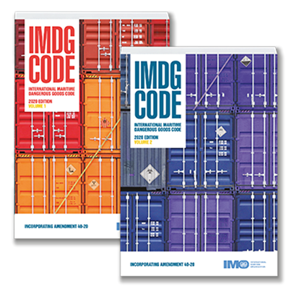
Important Regulatory Manuals
United Nations Transport of Dangerous Goods Model Regulations “Orange Book”
49 CFR
US Domestic/International
All Modes
Annual Editions
IMO/IMDG Code
International
Marine Transport
Bi-annual Editions
2-Part Manual
ADR
European(+) Domestic
Road Transport
Bi-annual Editions
TDG
Canadian Domestic
All Modes
Bi-annual Editions
IATA/ICAO DGR
International
Air Transport
Annual Editions (IATA)
Bi-annual Editions (ICAO)

Slide 4
Other Regulatory Manuals
GHS

Slide 5
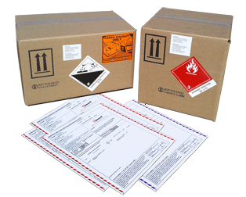
Shipper’s Responsibilities [49 CFR 171.2(e)]
Classification
Identification
Packing
Marking/Labeling
Documentation
Providing Placards
Retention of Records
Training

Slide 6
Operator Responsibilities
[49 CFR 171.2(f)]
Acceptance
Storage / Loading
Inspection
Placarding Vehicle
Provision of Information, including Emergency Response information
Reporting
Retention of Records
Training

Slide 7
Glossary
Definition of Hazardous Material
Glossary to identify definitions for terms in the 49 CFR is found in [49 CFR 171.8].
It is important to note that the shipper is responsible for identifying and classifying all dangerous goods intended for transport in compliance with the 49 CFR, as stated in [49 CFR 173.22].

Slide 8
Who Requires Hazmat Training
Anyone who performs a Hazmat Function or Pre-Transportation Function:
Classifying a Hazmat
Preparing a Hazmat package
Loading/unloading Hazmat in transportation
Preparing, reviewing, certifying Hazmat documentation
Designing, making, marking, labeling Hazmat packaging
Operating a vehicle containing Hazmat and/or segregating Hazmat within the transport vehicle
Directly managing Hazmat employees
Offering or affixing a placard on a vehicle for Hazmat transportation
[49 CFR 171.1; 171.8; Part 172 Subpart H]

Slide 9
Types of Required Hazmat Training:
General Awareness [49 CFR 172.704(a)(1)]
Function-specific [49 CFR 172.704(a)(2)]
Safety Awareness [49 CFR 172.704(a)(3)]
Security Awareness [49 CFR 172.704(a)(4)]
In-depth Security [49 CFR 172.704(a)(5), 172.800]

Slide 10
Frequency of Hazmat Training
Initial
Within 90-days of employment or change in job function [49 CFR 172.704(c)(1)]
Recurrent
Ground- 3 years [49 CFR 172.704(c)(2)]
Air- 2 years
Marine- no specification, but must adhere to Competent Authority standards (for example US 49 CFR)

Slide 11
Training Record Requirements
Training records must be retained for: [49 CFR 172.704(d)]
For as long as the employee is employed and for at least 90-days after termination of employment
The record must include the preceding 3 years of training records
The following must appear on each training record: [49 CFR 172.704(d)(1-5)]
The hazmat employee’s name;
The most recent training completion date;
A description, copy or the location of the training materials used to meet the requirements;
The name and address of the person providing the training; and
A certification that the hazmat employee has been trained and tested.

Slide 12
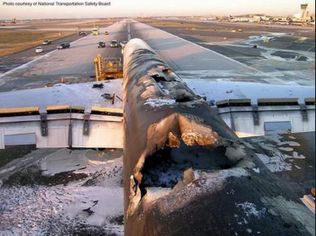
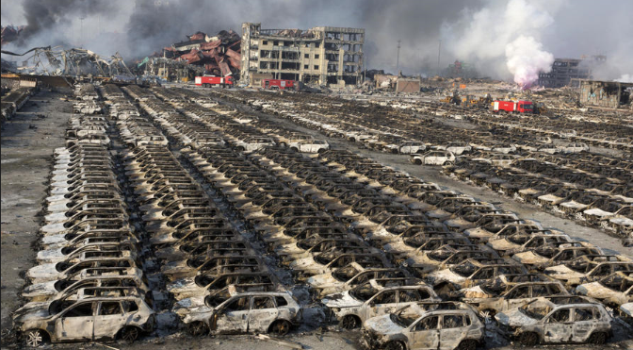
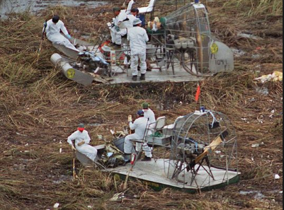
Need For Training
Safety Ramifications
Fines
Jailtime
Revocation of Shipping Rights (carrier and state)
Environmental Damage (property and Earth)
Reputation Damage
Customer Loss
Employment Termination
Shipment delays
Carrier imposed fines

Slide 13
When the violation is a continuing one, each day of the violation constitutes a separate offense. Not complying can cost you!
Consequences of Non-Compliance
[49 CFR Part 107, Subpart D – Enforcement]
Knowing Violations
Up to $96,624 per violation
“You should have known”
Willful/Reckless Violations
Up to $96,624 + up to 5 years imprisonment
Proven purposely committed or extremely negligent
Death, Serious Illness/Injury or Substantial Property Damage Violations
Up to $225,455 per violation + up to 10 years imprisonment
Training Violations
minimum penalty of $582 per violation related to training

Slide 14
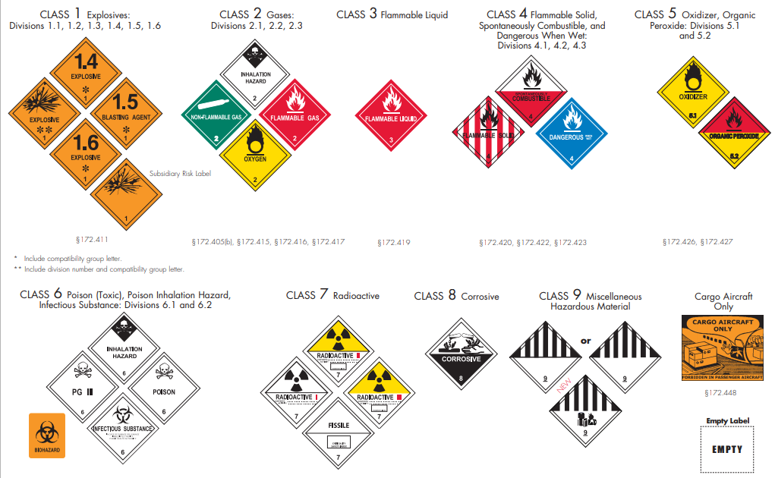
Classification

Slide 15
THERE ARE 9 HAZARD CLASSES
Classification criteria for each hazard class and division is found in 49 CFR Part 173.
If results of specified tests fall within established criteria, the material becomes “classified” and regulated accordingly.

Slide 16
The Nine Hazard Classes [49 CFR 173.2]
Class 1 – Explosives*
Class 2 – Gases*
Class 3 – Flammable Liquids
Class 4 – Flammable Solids*
Class 5 – Oxidizers and Organic Peroxides*
Class 6 – Toxic and Infectious Substances*
Class 7 – Radioactive Substances
Class 8 – Corrosives
Class 9 – Miscellaneous
*Hazard Classes further divided into Divisions

Slide 17
Hazard Divisions
Some of hazard classes are further subdivided into divisions to identify the specific hazard associated within the class.
For example Class 2 - Gases, is subdivided into:
Division 2.1 (flammable gas)
Division 2.2 (non-flammable, non-toxic gas)
Division 2.3 (toxic gas)

Slide 18
The 3 Packing Groups [49 CFR 171.8]
Assigned based on the degree of hazard:
Dictate packaging and containment requirements
Determine quantity and modal restrictions
Often abbreviated PG
Always written in Roman Numerals
Only certain Hazard Classes have Packing Groups

Slide 19
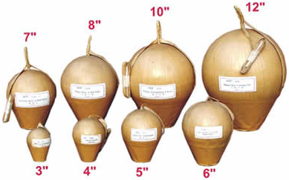
Class 1 – Explosives
[starts at 49 CFR 173.50]

Slide 20
Class 2 – Gases [starts at 49 CFR 173.115]
Division 2.1:
Flammable Gas
Division 2.2:
Non-Flammable Gas, Non-Toxic Gas
Division 2.3:
Toxic Gas

Slide 21
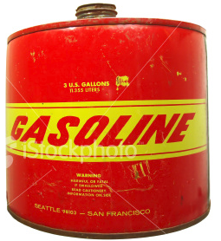
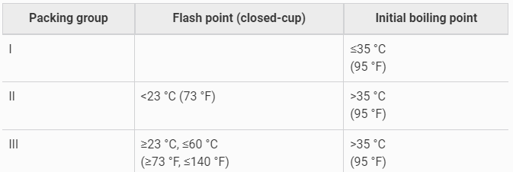
Class 3 – Flammable Liquid
[starts at 49 CFR 173.120]
§173.121 Class 3 – Assignment of Packing Groups

Slide 22
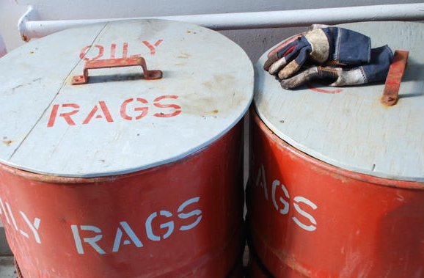
Class 4 – Flammable Solids; Substances Liable to Spontaneous Combustion; Dangerous When Wet [starts at 49 CFR 173.124]
Division 4.1:
Flammable Solids; Self-reactive Substances, Polymerizing Substances; and Desensitized Explosives
Division 4.2:
Substances Liable to Spontaneous Combustion
Division 4.3:
Substances which, in contact with water emit Flammable Gases
(Dangerous When Wet)

Slide 23
Class 5 – Oxidizing Substances and
Organic Peroxides
[starts at 49 CFR 173.127]
Division 5.1
Oxidizers

Slide 24
Class 5 – Oxidizing Substances and
Organic Peroxides
[starts at 49 CFR 173.128]
Division 5.2
Organic Peroxides

Slide 25
Class 6 – Toxic and Infectious Substances
[starts at 49 CFR 173.132]
Division 6.1
Toxic Substances
§173.133 Division 6.1 Materials – Assignment of Packing Groups

Slide 26
Class 6 – Toxic and Infectious Substances
[starts at 49 CFR 173.132]
Division 6.2
Infectious Substances

Slide 27
Class 7 – Radioactive Materials [starts at 49 CFR 173.403]
Category I
WHITE
(No Transport Index)
Category II
YELLOW
(Transport Index)
Category III
YELLOW
(Transport Index)

Slide 28
Class 7 – Radioactive Materials [starts at 49 CFR 173.403]

Slide 29
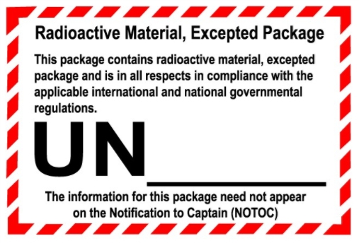
Class 7 – Radioactive Material (Excepted Packages)

Slide 30
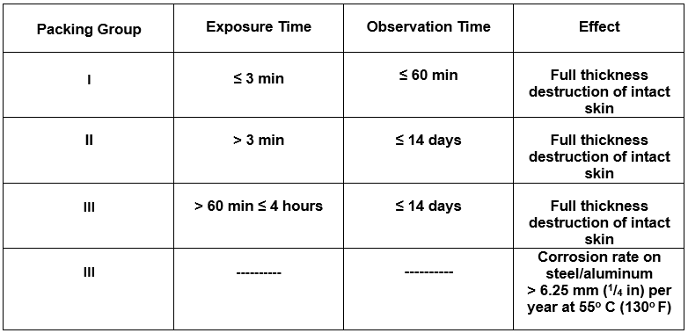
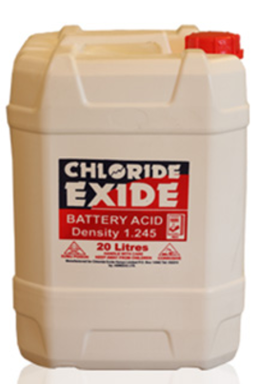
Class 8: Corrosive Materials
[starts at 49 CFR 173.136]
§ 173.137 Class 8 – Assignment of Packing Groups

Slide 31
Class 9 - Miscellaneous Hazardous Materials
[starts at 49 CFR 173.140]
(Class 9 Lithium Battery Hazard Label)

Slide 32
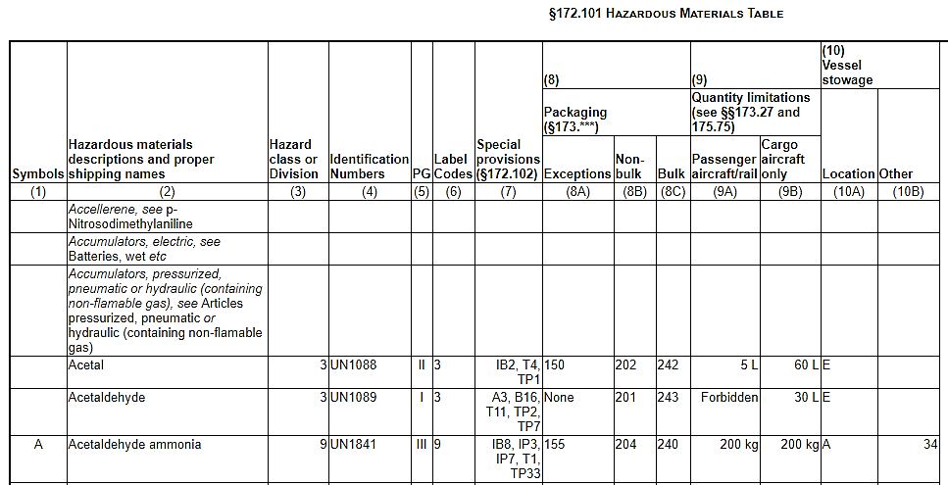
Hazardous Materials Table (HMT)

Slide 33
Safety Data Sheets
(formerly Material Safety Data Sheets)
A Safety Data Sheet (SDS) is a detailed informational document prepared by the manufacturer or importer. It describes the physical and chemical properties of the product.
SDSs contain useful information such as:
Toxicity, flash point, procedures for spills and leaks, storage guidelines, exposure control and transportation information

Slide 34
Relevant Components of
GHS-compliant SDS
Section 3:
Composition/Ingredient Information
Section 5/6:
Firefighting/Accidental Release Measures
Section 9:
Physical and Chemical Properties
Section 11:
Toxicological Information
Section 12:
Ecological Information

Slide 35
Section 14 of a GHS-compliant SDS:
Transportation
UN/ID Number – a four-digit number that identifies hazardous materials or articles (e.g. explosives, flammable liquids, toxic substances, etc.).
Transportation Proper Shipping Name – the Proper Shipping Name (PSN) accurately describes the hazards of the goods being transported.
Transport hazard class/division & Sub hazard – substances and articles are assigned to a transport hazard class based on its most predominant hazard and may pose subsidiary hazards.
Packing group – a packing group number will be assigned depending on its degree of hazard (e.g. I, II, III) if applicable.
Environmental hazards – if the substance is a known marine pollutant, then it may indicate as either a “marine pollutant” or a “severe marine pollutant” and/or “reportable quantity.”

Slide 36
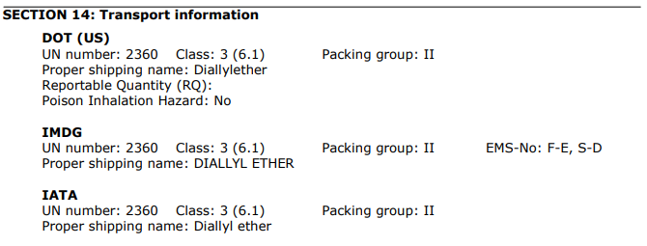
SDS Section 14- Transportation
*Note: Section 14 is not required to be completed on SDS and not all SDSs are created equal!

Slide 39
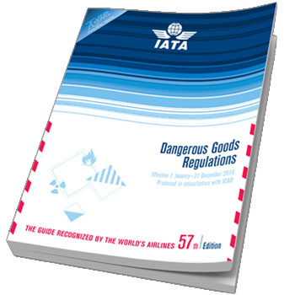
Most Air Carriers Use:
IATA = Air Industry Preferred Compliance Regulations
Just to name a few. . .

Slide 40
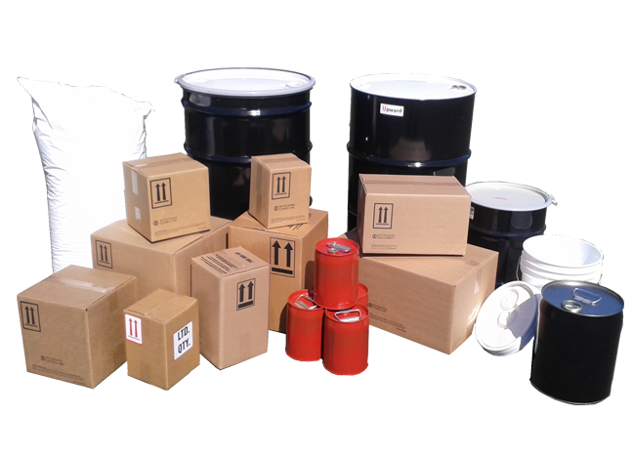
Packagings and Packing Requirements

Slide 41
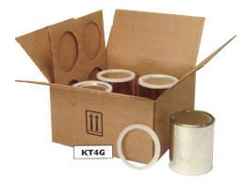
Types Non-bulk Packaging
COMBINATION PACKAGINGS: a combination of packagings, for transport purposes, consisting of one or more inner packagings secured in a non-bulk outer packaging. It does not include a composite packaging.
COMPOSITE PACKAGINGS: Packaging consisting of an outer packaging and an inner receptacle so constructed that the inner receptacle and the outer packaging form an integral packaging. Once assembled, it remains thereafter an integrated single unit; it is filled, stored, transported and emptied as such.
SINGLE PACKAGINGS: A non-bulk packaging other than a combination packaging.
Combination
Composite
Single

Slide 42
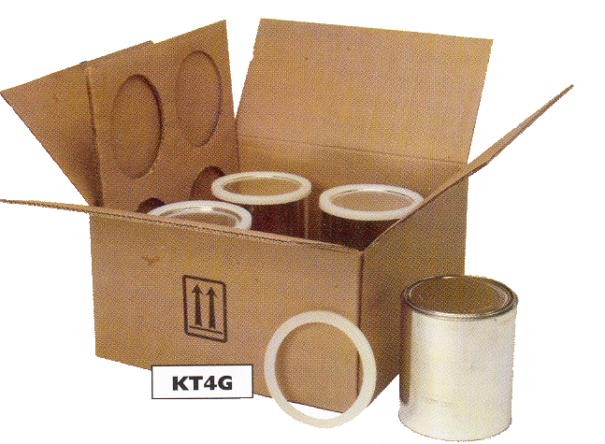
Combination Packagings
Outer and Inner Packaging
Suitable and adequate absorbent/cushioning material
Completed PACKAGE

Slide 43
UN Specification Packagings
§ 178.503(e)(1) Package specification will be identified by a code beginning with:
The UN packaging symbol indicates the packaging has been tested and has passed UN packaging performance tests.
An example of a UN marking: 4G / X31 / S / 13 / USA / +AQ2121

Slide 44
Packaging Intended to contain
Solids/Inner Packagings
4G/Z25/S/18/USA/BH05W

Slide 45
Single Packaging intended to contain Liquids
1A1/X1.8/250/17/ZA/TE7075

Slide 46
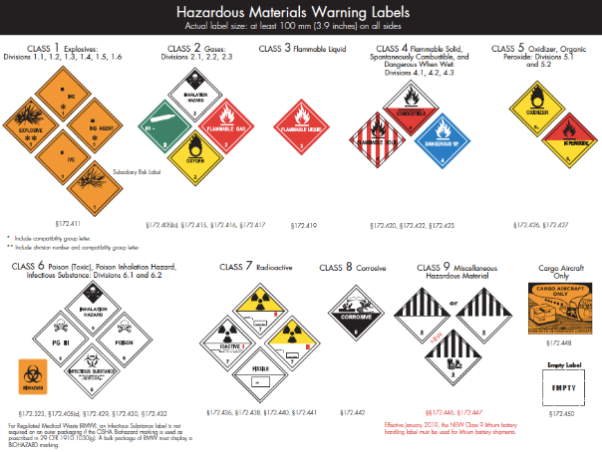
Marking and Labeling

Slide 47
The Completed Package
UN 2360
DIALLYLETHER
FROM:
TO:
PSN & ID Number
To or From
Address Label
Handling Mark(s)
4G/Y9/S/19/USA/BH05W
UN Specification Package Marking
Hazard Label(s)

Slide 48
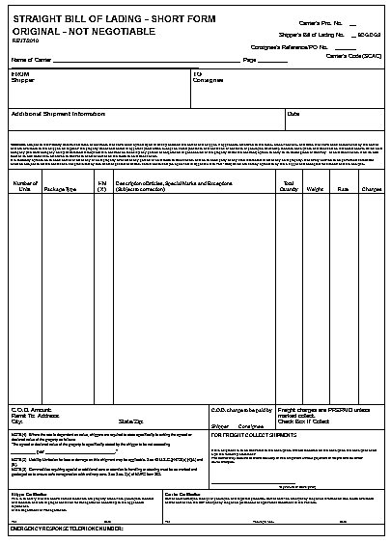
Documentation

Slide 49
Types of Shipping Documentation
Shipping Paper – 49 CFR Part 172, Subpart C
Ground and Rail
No required format
Can be a Bill of Lading (BOL) or Hazardous Waste Manifest
Shipper’s Declaration of Dangerous Goods (DGD) – IATA Section 8
Air
Required format- “Red Candy Stripes”
Often carrier required software- FX-18
International Maritime Organization Declaration (IMO Dec) – IMDG Chapter 5.4
Vessel
No required format- often see “Blue Candy Stripes”
Steamship-specific requirements often apply

Slide 50
Shipping Paper Retention § 172.201
Each person who provides a shipping paper must retain a copy of the shipping paper or an electronic copy thereof that is accessible at or through its principal place of business and must make shipping paper available upon request to authorized government representatives.
Two (2) years for all other hazardous materials after the material is accepted by the initial carrier
Three (3) years for hazardous wastes after the material has been accepted by the initial carrier

Slide 51
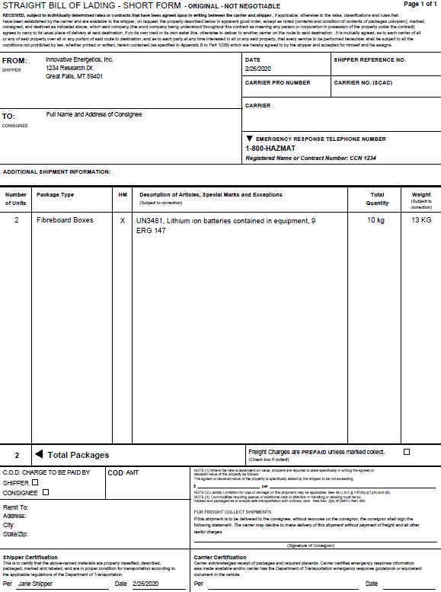
The Completed Form:
Hazmat Ground
Bill of Lading (BOL)

Slide 52
Segregation
§177.848
Basic Segregation and Separation Rules:
For detailed instructions refer to Subpart C – Segregation
and Separation Chart of Hazardous Materials – 49 CFR 177.848
O - Separate in vehicle/storage area
X - Do not ship or store together
* - See 177.848
Use for Segregation and Compatibility!

Slide 53
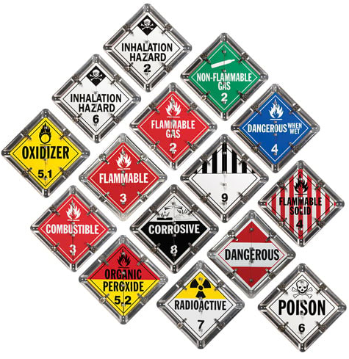
Placarding

Slide 54
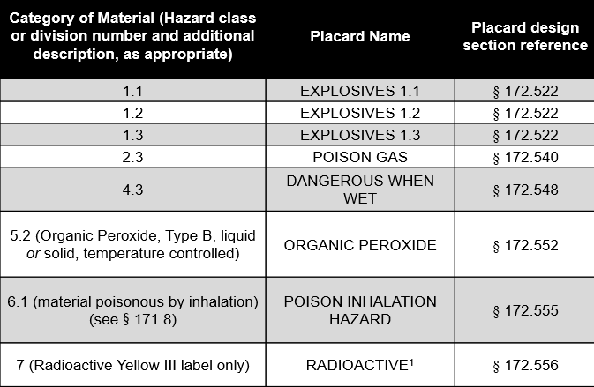
Placarding Table 1 [49 CFR 172.504]
Placards required at any quantity!
Unless otherwise specified in the subchapter.

Slide 55
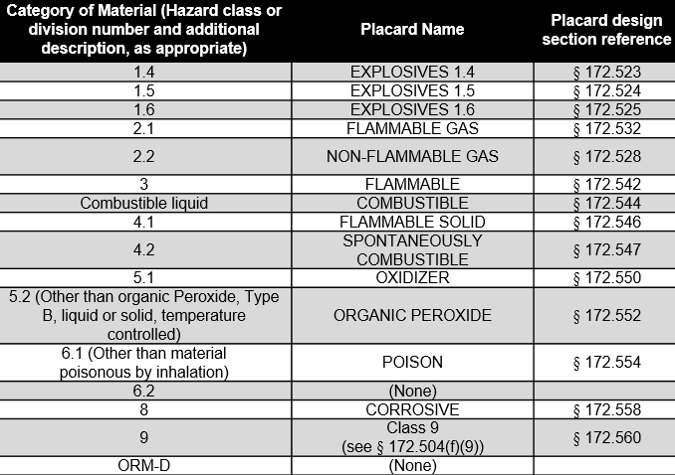
Placarding Table 2 [49 CFR 172.504]
For less than 454 kg (1001 lbs.) aggregate gross weight of hazardous materials covered by Placarding Table 2, placards are not required.

Slide 56
Placard Placement
One on each side and each end (FOUR total)
or

Slide 57
Emergency Response Information

Slide 58
Emergency Response Guidebook
Yellow pages: Allow users to look up material by UN Number.
Blue pages: Allow users to look up material by Proper Shipping Name.
Orange pages: Contain the numbered emergency response guides.
Green pages: Contain Initial Isolation Tables for Toxic-by-Inhalation materials, certain chemical warfare agents, and water reactive materials that produce toxic gases when in contact with water.

Slide 59
Good Luck!

