Slide 1

NC OSHA Update
American Society of Safety Professionals – Tarheel Chapter
January 4, 2024
Paul M. Sullivan, CIH, CSP
Assistant Deputy Commissioner
Occupational Safety and Health Division
paul.sullivan@labor.nc.gov
Notes:
The information in this presentation is provided voluntarily by the N.C. Department of Labor, Education Training and Technical Assistance Bureau as a public service and is made available in good faith. This presentation is designed to assist trainers conducting OSHA outreach training for workers. Since workers are the target audience, this presentation emphasizes hazard identification, avoidance, and control – not standards. No attempt has been made to treat the topic exhaustively. It is essential that trainers tailor their presentations to the needs and understanding of their audience.
The information and advice provided on this Site and on Linked Sites is provided solely on the basis that users will be responsible for making their own assessment of the matters discussed herein and are advised to verify all relevant representations, statements, and information.
This presentation is not a substitute for any of the provisions of the Occupational Safety and Health Act of North Carolina or for any standards issued by the N.C. Department of Labor. Mention of trade names, commercial products, or organizations does not imply endorsement by the N.C. Department of Labor.

Slide 2
Objectives
Develop an understanding of OSHNC activities and findings during FY2023 (10/1/22 to 9/30/23) and the emphases for FY2024.
  North Carolina TRC rates and trends
  OSH Division bureaus, alliances and partnerships
  FY2023 inspection and citation information
  FY2023 fatality information
  Special Emphasis Programs
  Current challenges

Slide 3

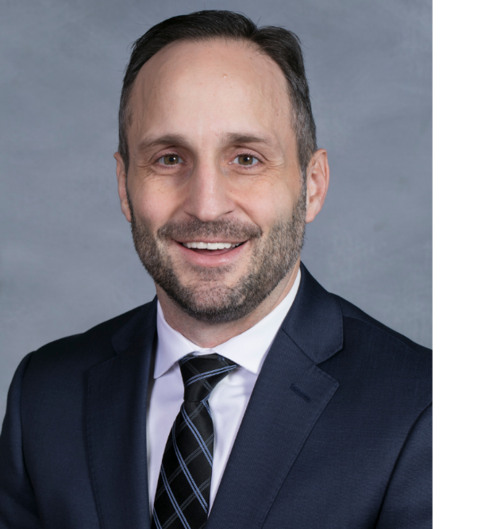
So…what’s happening at NCDOL?
Year #3 of Commissioner Josh Dobson’s first term is officially in the books (almost)…

Slide 4
So…what’s happening at NCDOL?
…and, unfortunately, he recently announced that he will not be running again in 2024.

Slide 5
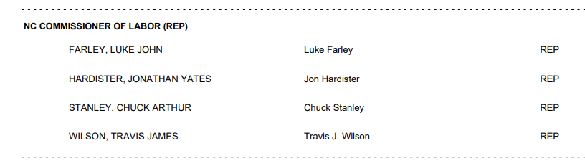
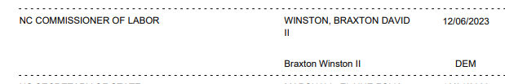
2024 Labor Commissioner Election Preview

Slide 6
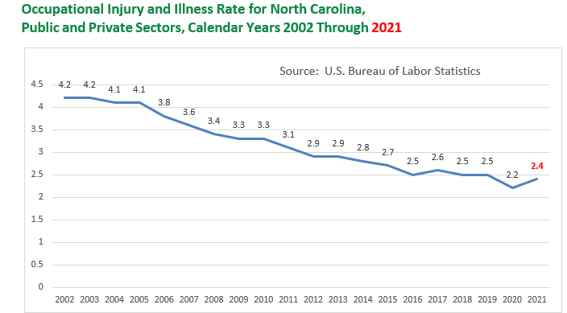
TRC Trend Since 2002
2022 numbers were just recently released by BLS.
The NC private and public sector TRC rate stayed the same at 2.4.
Private sector (only) TRC comparison:
  Nationwide – 2.7
  North Carolina – 2.2

Slide 7

BLS TRC Data
Other TRC changes from 2021 to 2022:
  Construction rate decreased from 1.8 to 1.5
  Manufacturing rate decreased from 2.8 to 2.6
  Skilled Nursing Facilities saw a notable increase in the TRC rate from 8.0 in 2021 to 14.7 in 2022.
    Following the national trend, significant increases in the rates of respiratory infections (which include COVID-19) drove the rise in TRC rate for skilled nursing facilities. The respiratory illness rate for skilled nursing facilities grew from 343 cases per 10,000 FTE workers in 2021 to 1,063.9 cases per 10,000 FTEs in 2022.
Source: CDC

Slide 8
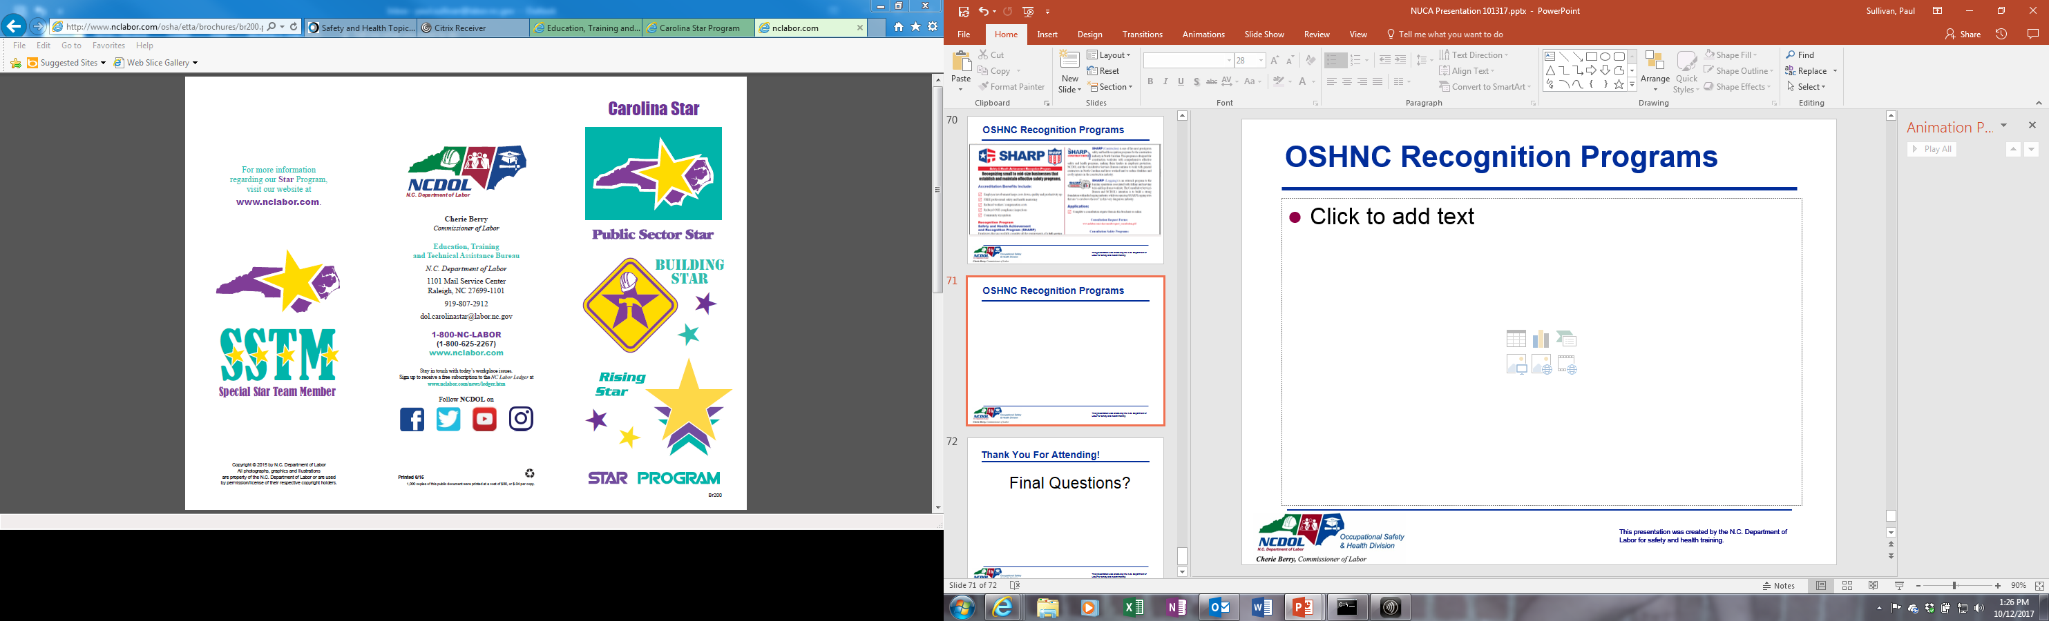
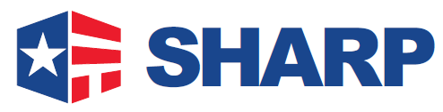
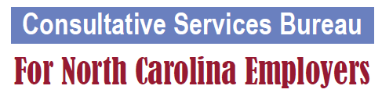
NCDOL/OSHNC
The low injury and illness rates are the result of combined efforts by employers, employees, OSHNC, professional associations, and others with an interest in worker safety & health.
OSHNC uses a multi-pronged approach, including (but not limited to):
  Education & training
  Consultative services
  Recognition programs
  Compliance

Slide 9
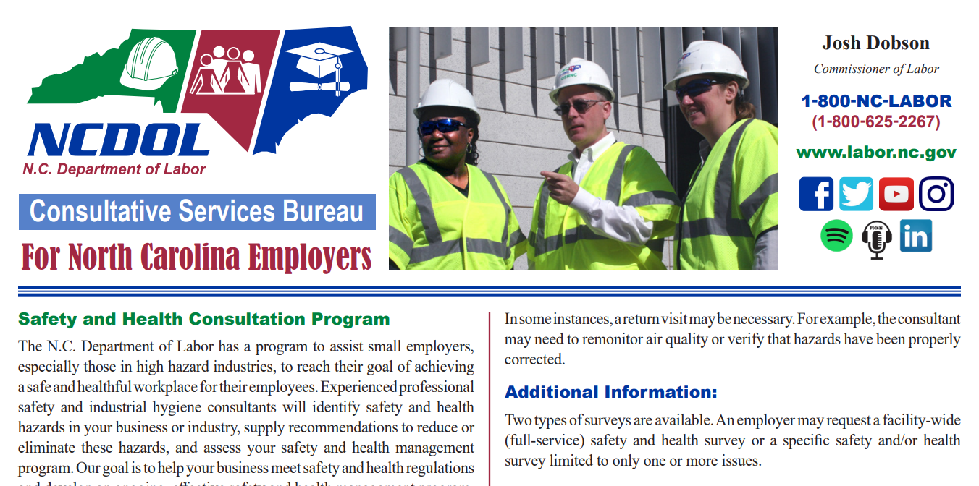
OSHNC Consultative Services

Slide 10
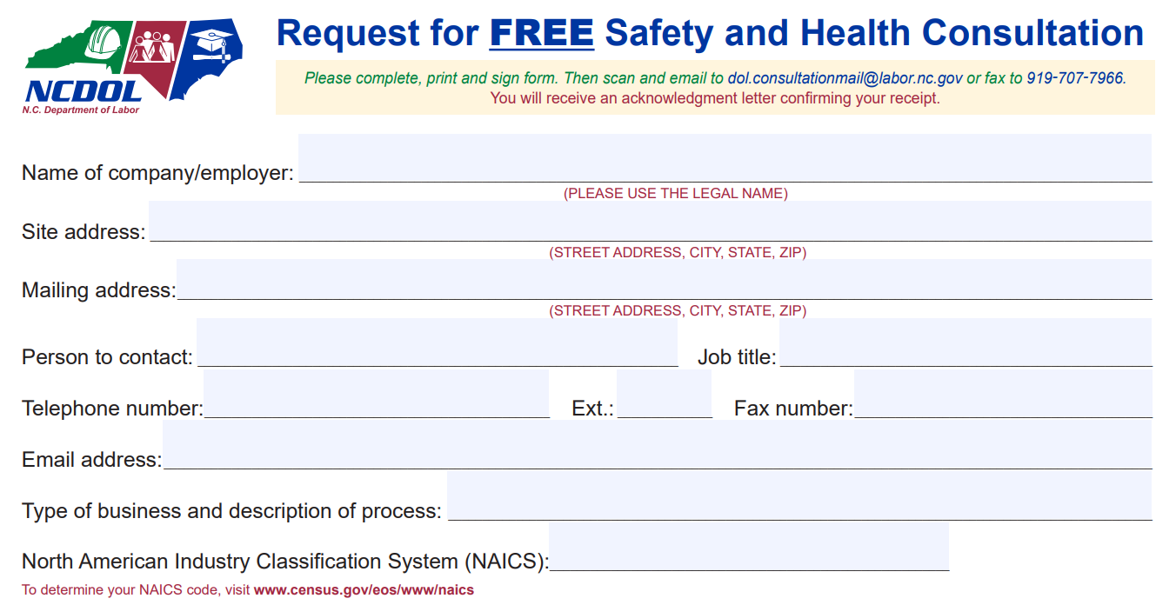
OSHNC Consultative Services

Slide 11
OSHNC Recognition Programs

Slide 12




OSH Division - Alliances and Partnerships
Alliances
  Carolinas AGC
  Lamar Advertising Company
  Mexican Consulate
  N.C. State – Industry Expansion Solutions
  Safety and Health Council of NC
  NUCA of the Carolinas
  NCALGESO
  Tree Care Industry Association
  Plumbing-Heating-Cooling Contractor’s Association
  N.C. Masonry Contractors Association (New! 11/16/2023)

Slide 13
OSH Division - Alliances and Partnerships
Partnerships
  Holder – Edison Foard – Leeper, A Joint Venture
    Charlotte - Charlotte Douglas International Airport – Terminal Lobby Expansion – Phase 5 (New! 2023 – 2024)
  Jacobs Engineering Group
    Holly Springs - Biotech Manufacturing Facility and Campus (2022 – 2024)
  Whiting – Turner Contracting Company (New! 11/6/2023)
    Siler City – Wolfspeed Semi-conductor/Silicon Carbide Plant (2023 – 2025)

Slide 14
OSH Compliance (18b State Plan)
East & West Bureaus
  96 OSHA inspectors (safety and health), including three whose duties partially include managing complaints/accidents investigated by letter.
  10 district supervisors
  2 bureau chiefs (East & West) and 1 assistant director
  Approximately 15 support staff (complaint desk, admin)
  Offices in Raleigh, Charlotte, Winston-Salem, Asheville, and Wilmington
Agriculture Safety & Health (ASH) – one bureau chief and a staff of eight.

Slide 15
OSH Compliance Activity – Inspections
Activity | FY2023 | FY2022 | FY2021 | FY2020 | FY2019
Total Compliance Inspections | 1762 | 1956 | 2217 | 2107 | 2928
Construction Inspections | 915 | 1050 | 1190 | 1285 | 1682
Fatality Inspections | 76 | 73 | 85 | 71 | 54
Complaint % | 19.0% | 23.9% | 19.3% | 17.4% | 20.0%
Referral % | 11.2% | 9.8% | 10.1% | 8.7% | 8.9%
Follow-up % | 3.1% | 2.9% | 2.9% | 2.7% | 3.6%
Public Sector % | 6.7% | 4.8% | 5.7% | 4.6% | 6.4%

Slide 16
OSH Compliance Activity - Citations
Activity | FY2023 | FY2022 | FY2021 | FY2020
Total Compliance Inspections | 1762 | 1956 | 2217 | 2107
% of Inspections without Violations (In-Compliance) | 35.8% | 39.0% | 36.4% | 35.2%
% of Inspections with Serious, Willful or Repeat Violations | 53.9% | 52.7% | 53.8% | 56.1%
Total Violations | 4118 | 4376 | 5406 | 4955
Serious Violations | 2729 | 2989 | 3413 | 3388
Repeat Violations | 92 | 177 | 210 | 203
Willful Violations | 10 | 10 | 21 | 12
SWR Violations/Inspection | 1.61 | 1.62 | 1.64 | 1.71
Total Current Penalty | $9.32M | $7.31M | $6.63M | $6.19M
Average Penalty per Inspection | $5291 | $3739* | $2992 | $2936
% of Inspections with Citations Contested | 4.1% | 4.3% | 4.1% | 5.2%
*New OSHNC penalties went into effect for citations issued after 10/01/2022.

Slide 17
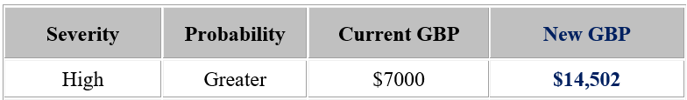
Even Newer Penalties
– as of 7/1/2023
$15,625
New maximum penalty for a willful-serious violation is $145,027.
New minimum penalty (after credits) for a serious violation is $750.
$156,259

Slide 18
FY 2023 Fatalities
Source: Occupational Fatality Inspection Review (OFIR)

Slide 19
OFIR Report is on the NCDOL Website

Slide 20
FY 2023 Fatalities – Struck-by Events
Of the 17 struck-by events, only two were in the construction industry.
Some examples:
  Struck-by a backing (and turning) forklift at a lumber company
  Struck-by a forklift entering a trailer at manufacturing company
  Struck-by an exploding tractor tire (that was being inflated)

Slide 21
FY 2023 Fatalities – Caught In/Between Events
Of the 10 caught in/between events, only one was in the construction industry.
Most are energy control (lockout tagout) or guarding issues.
Some examples:
  Caught in a moving conveyer at a lumber company
  Caught in machinery at a manufacturing plant while attempting to retrieve product

Slide 22
FY 2023 Fatalities – “Other” Events
Of the 12 “other” events, only two were in the construction industry.
Some examples:
  Chemical explosion at a manufacturing plant.
  Two fatalities due to heat-related illness
  Flash fire while filling a propane cylinder.

Slide 23
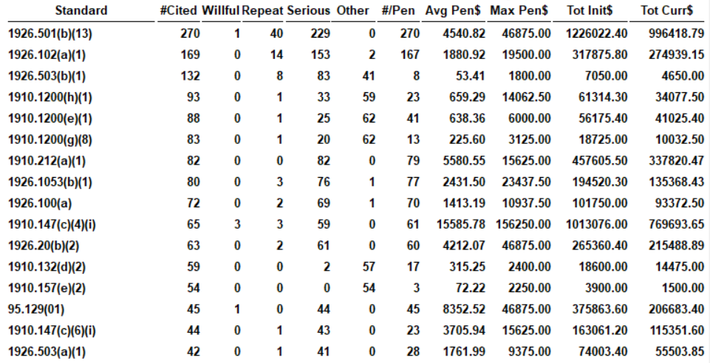
FY 2023 Frequently Cited Standards
Fall Protection
Residential construction – no fall protection
Fall protection training or certification

Slide 24
FY 2023 Frequently Cited Standards
PPE Violations
Eye protection
Head protection
Certification of PPE hazard assessment

Slide 25
FY 2023 Frequently Cited Standards
Hazard Communication
Training
Written program
Maintaining SDS

Slide 26
FY 2023 Frequently Cited Standards
Machine Guarding/LOTO
Machine guarding
Failure to develop, document, and utilize energy control procedures
Annual audits of energy control procedures.

Slide 27
FY 2023 Frequently Cited Standards
Other Construction Violations
Ladders not extended more than 3’ above the upper landing surface
Frequent & regular jobsite inspections

Slide 28
FY 2023 Frequently Cited Standards
Last, but not least…
Monthly fire extinguisher inspections.
General Duty Clause violations.

Slide 29
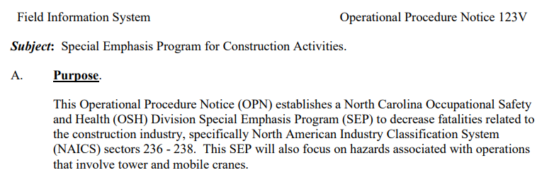
OSHNC Special Emphasis Programs (SEPs)
§ 95-136.1. Special emphasis inspection program.
(a) As used in this section, a "special emphasis inspection" is an inspection by the Department's occupational safety and health division that is scheduled because of an employer's high frequency of violations of safety and health laws or because of an employer's high risk or high rate of work-related fatalities or work-related serious injuries or illnesses.

Slide 30
OSHNC Strategic Plan
OSHNC has a Strategic Plan with a five-year cycle. There are two main outcome goals. The various SEPs fall under these goals.
We just completed the FY19-23 cycle. The new FY24-28 cycle started on 10/1/2023.
In March 2023, senior staff and team leaders met to evaluate each SEP and look at BLS data to plan for the new 5-year cycle.
OSH Outcome Goal #1 | By the end of FY 2028, reduce the rate of workplace fatalities by 2%.
OSH Outcome Goal #2 | By the end of FY 2028, reduce the rate of workplace injuries and illnesses by 5%.

Slide 31
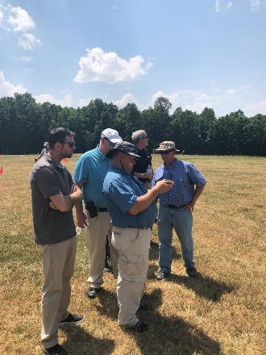
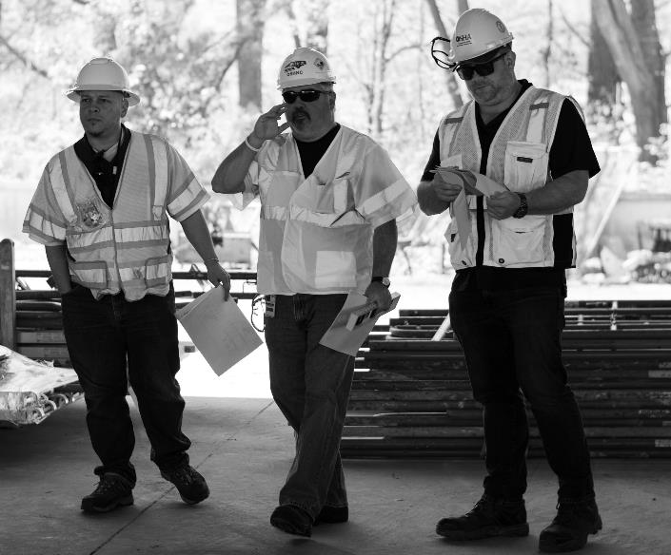
Strategic Plan – SEPs for FY19-23
Reduce Workplace Fatalities
Construction
Logging and Arboriculture
Reduce Workplace Injuries & Illnesses
Long Term Care Facilities
Health Hazards
Food Manufacturing
Grocery and Related Product Wholesalers
Amputations

Slide 32
Strategic Plan – SEPs for FY24-28
Reduce Workplace Fatalities
Construction
Logging and Arboriculture
Reduce Workplace Injuries & Illnesses
Long Term Care Facilities
Health Hazards
Food Manufacturing
Grocery and Related Product Wholesalers
Amputations

Slide 33
Strategic Plan – SEPs for FY24-28
Reduce Workplace Fatalities
Construction
Logging and Arboriculture
Reduce Workplace Injuries & Illnesses
Long Term Care Facilities
Health Hazards
Food Manufacturing
Amputations

Slide 34
Strategic Plan – SEPs for FY24-28
Reduce Workplace Fatalities
Construction
Logging and Arboriculture
Reduce Workplace Injuries & Illnesses
Long Term Care Facilities
Health Hazards
Food Manufacturing
Warehousing (still including Grocery NAICS codes)
Amputations

Slide 35
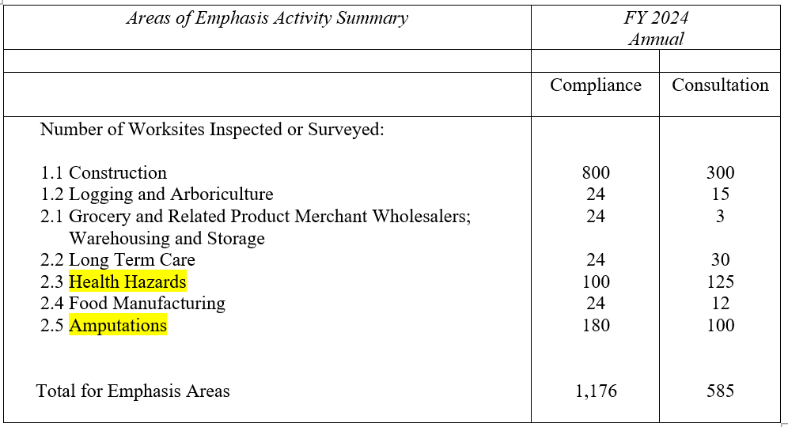
Goals for FY2024
Goals for the Health Hazards and Amputations SEPs were increased for FY24 due to the success of those programs.

Slide 36
Construction SEP

Slide 37

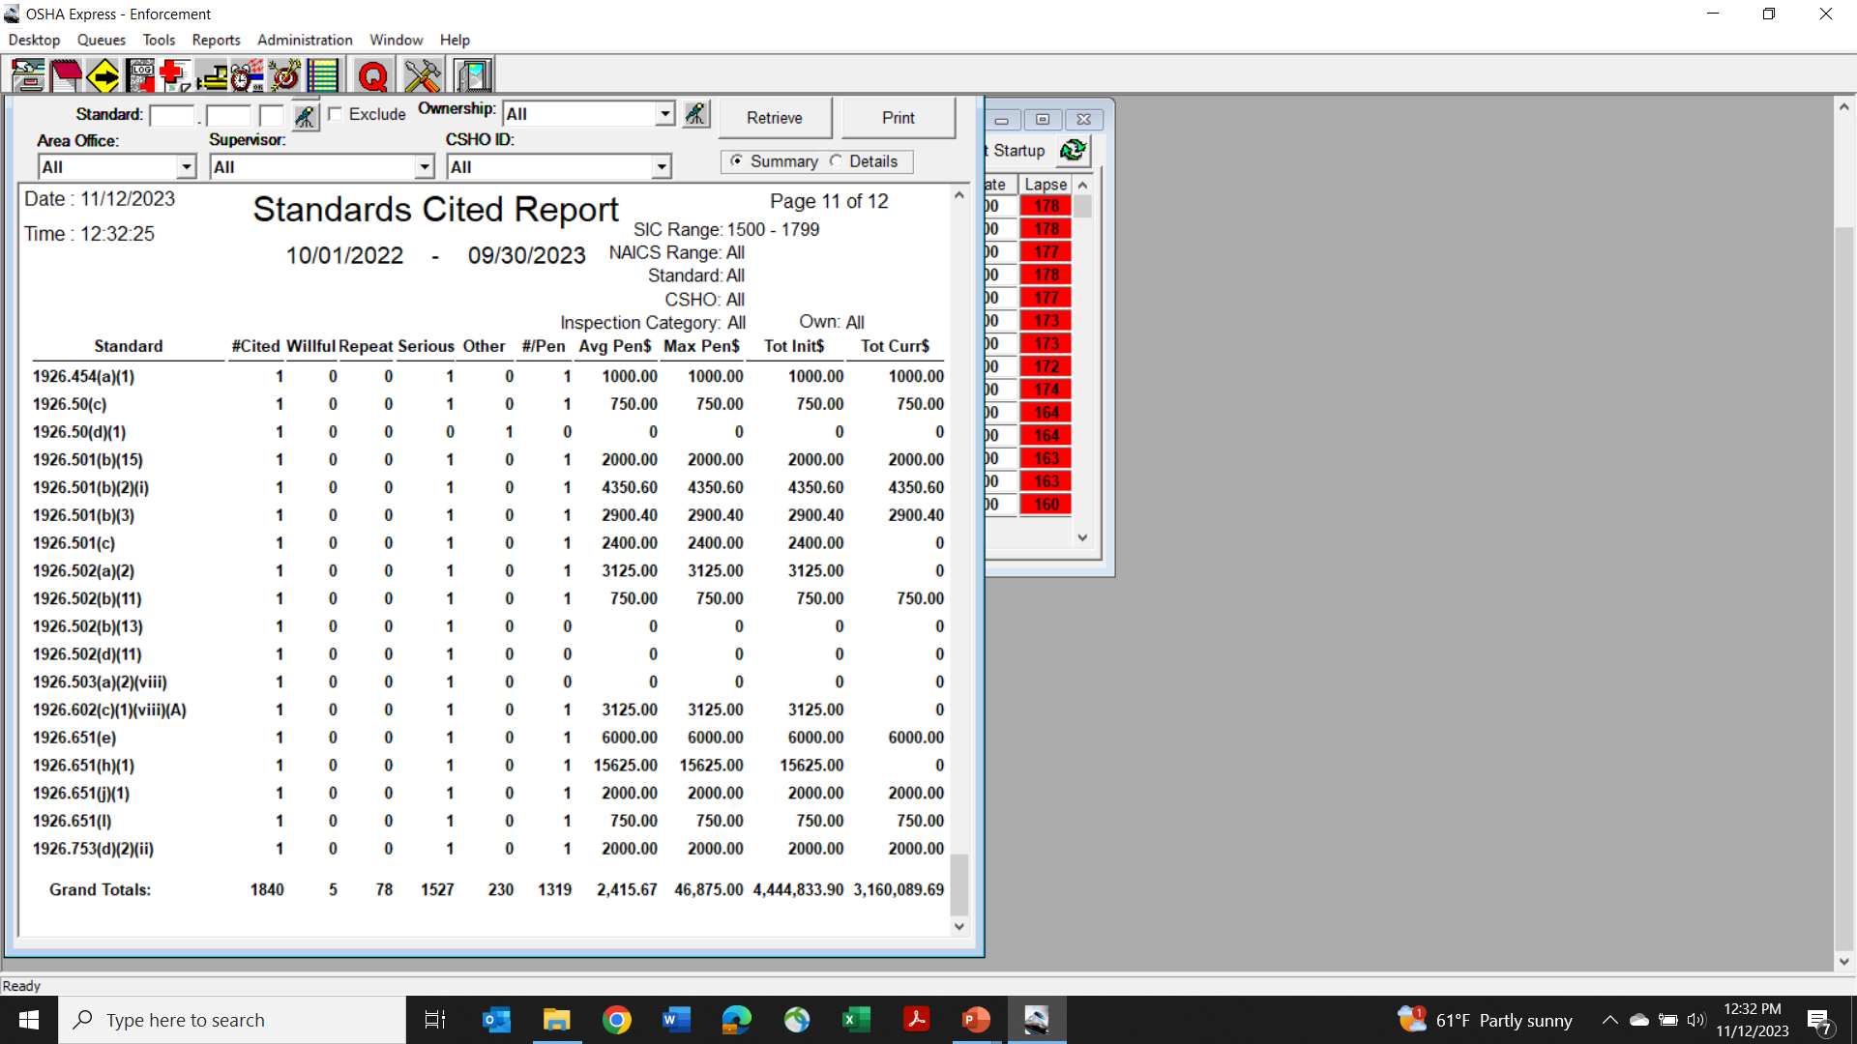
Construction SEP – FY2023
914 inspections in FY2023
Fall protection, fall protection training, PPE, ladders, scaffolds, and trenching are the most common violations.
1.76 SWR violations per inspection (average for all inspections is 1.61).

Slide 38
Construction SEP – FY2023
914 inspections in FY2023
Fall protection, fall protection training, PPE, ladders, scaffolds, and trenching are the most common violations.
1.76 SWR violations per inspection (average for all inspections is 1.61).

Slide 39
Construction SEP – FY2023
914 inspections in FY2023
Fall protection, fall protection training, PPE, ladders, scaffolds, and trenching are the most common violations.
1.76 SWR violations per inspection (average for all inspections is 1.61).

Slide 40
Construction SEP – FY2023
914 inspections in FY2023
Fall protection, fall protection training, PPE, ladders, scaffolds, and trenching are the most common violations.
1.76 SWR violations per inspection (average for all inspections is 1.61).

Slide 41
Construction SEP – FY2023
914 inspections in FY2023
Fall protection, fall protection training, PPE, ladders, scaffolds, and trenching are the most common serious violations.
1.76 SWR violations per inspection (average for all inspections is 1.60).

Slide 42
Construction SEP – FY2023
914 inspections in FY2023
Fall protection, fall protection training, PPE, ladders, scaffolds, and trenching are the most common serious violations.
1.76 SWR violations per inspection (average for all inspections is 1.61).

Slide 43
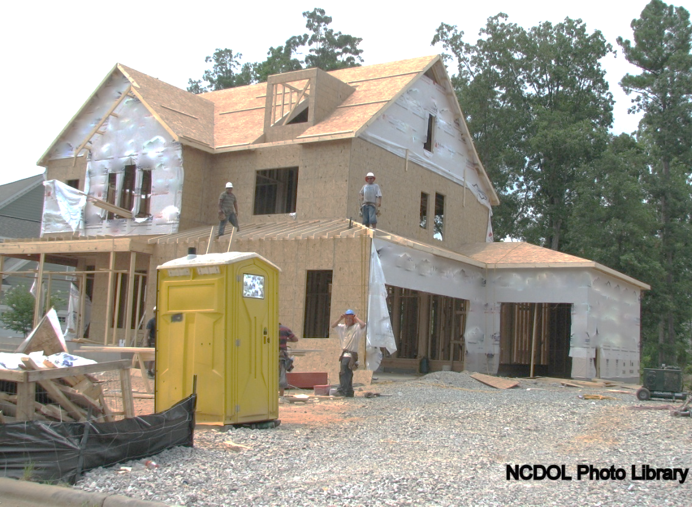
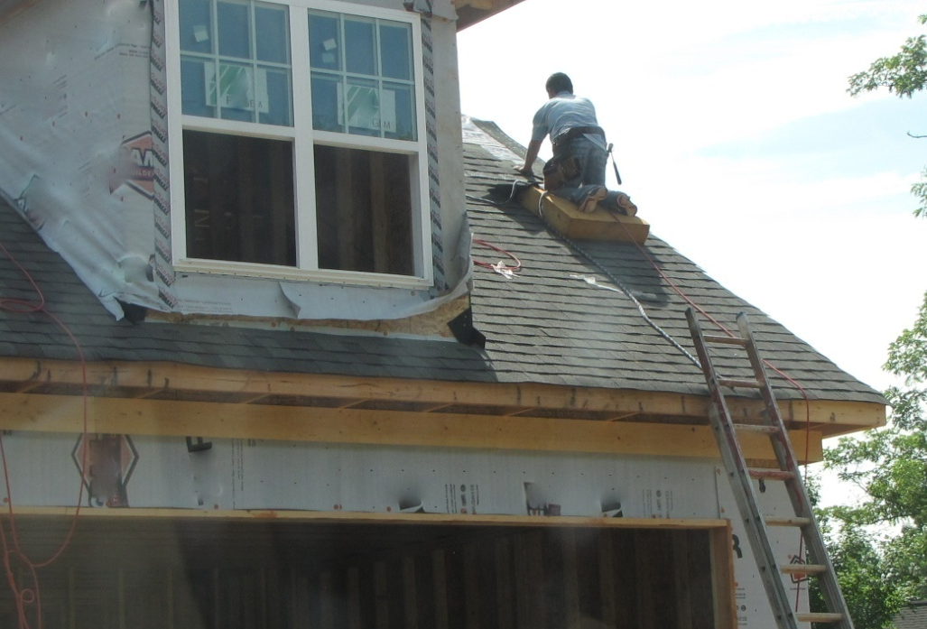
Construction SEP – Residential
NCDOL Photo Library
Notes:
NCDOL Photo Library: Closed Case# 314870627
NCDOL Photo Library: Closed Case# 316849306
No. Note ladder issues and lack of fall protection.

Slide 44
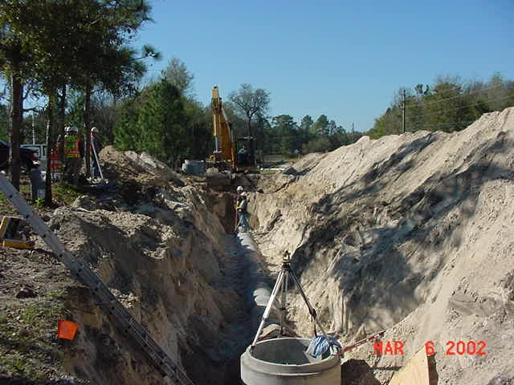
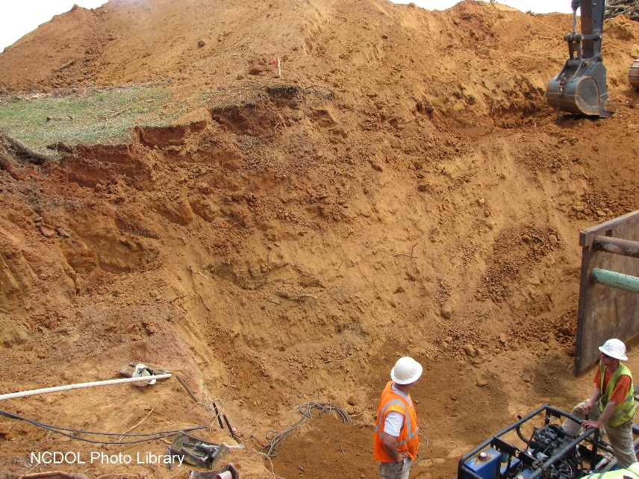
Construction SEP – Trenches
NCDOL Photo Library
Notes:
NCDOL Photo Library: OSHA Region 4 Photo Archive CD V1.0 2/2003 (NCDOL has received written approval)
NCDOL Photo Library - Closed Case File #317096345

Slide 45
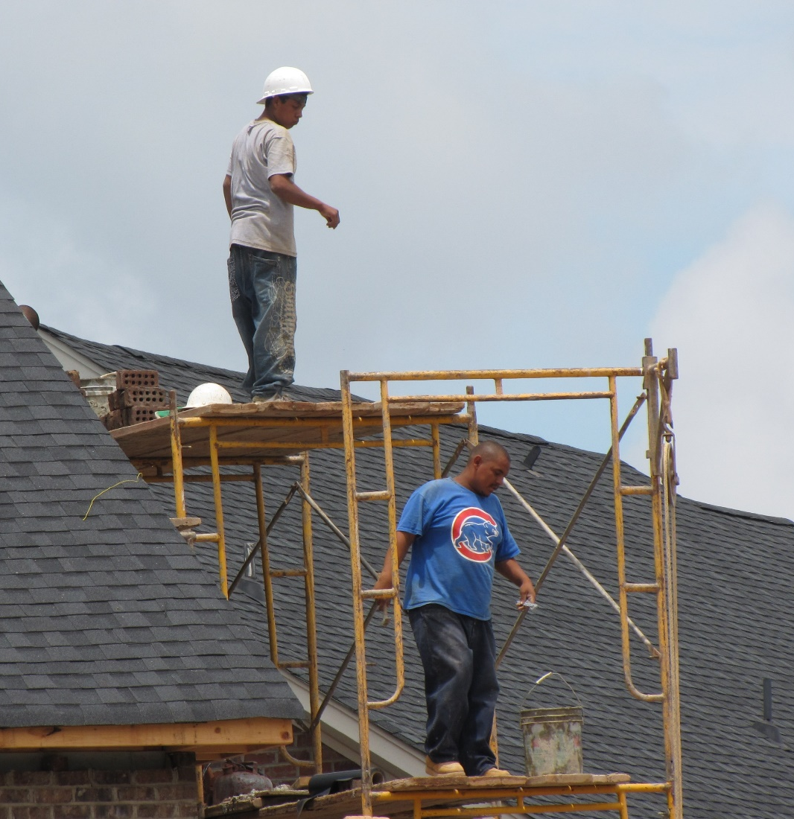
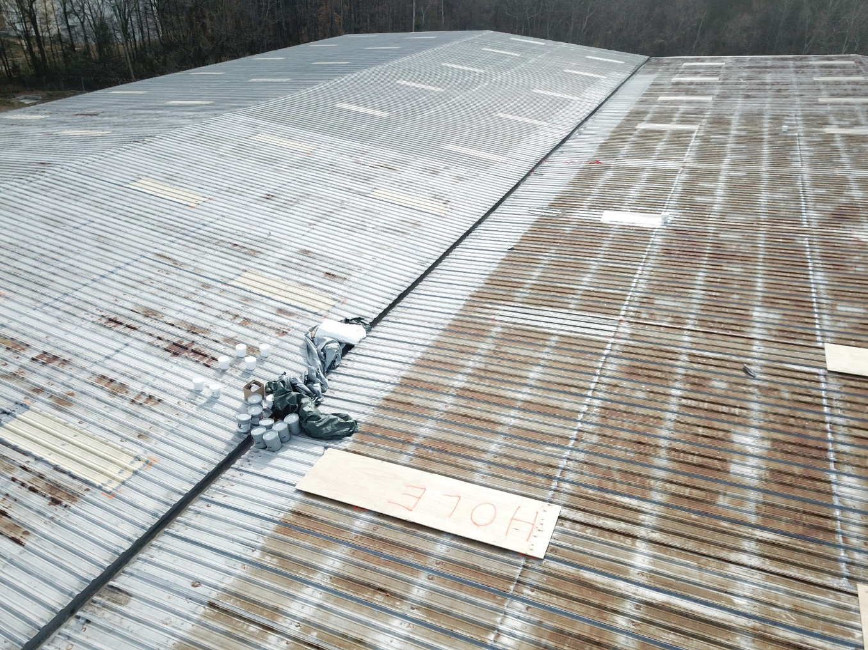
Construction SEP – Scaffolds and Skylights
NCDOL Photo Library
NCDOL Photo Library
Notes:
NCDOL Photo library – skylight closed inspection 318212438

Slide 46
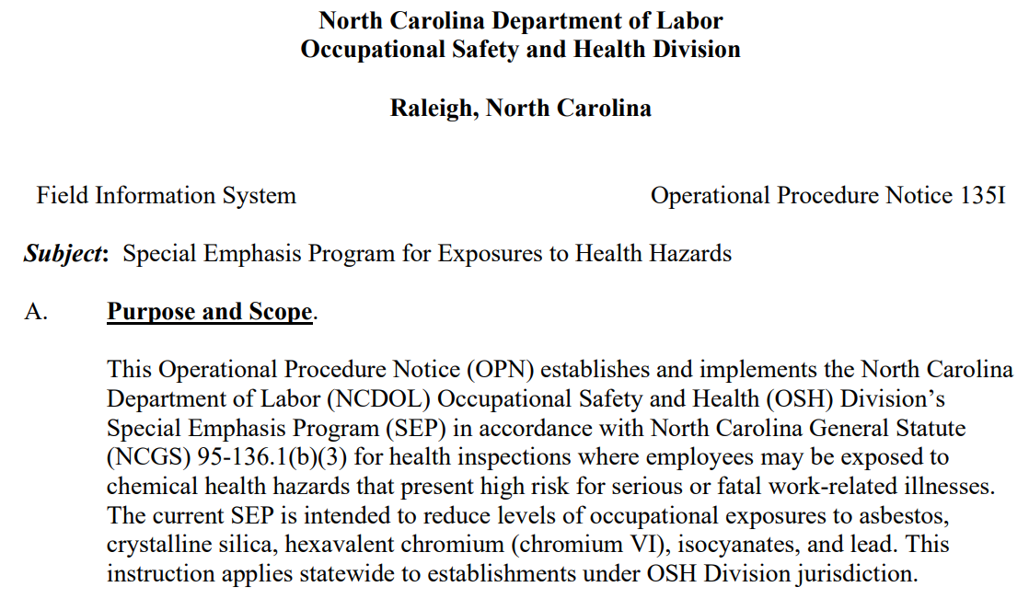
Health Hazards SEP

Slide 47
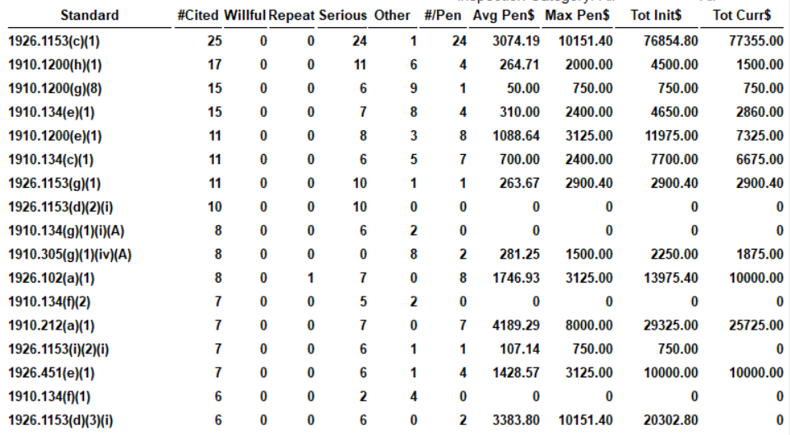
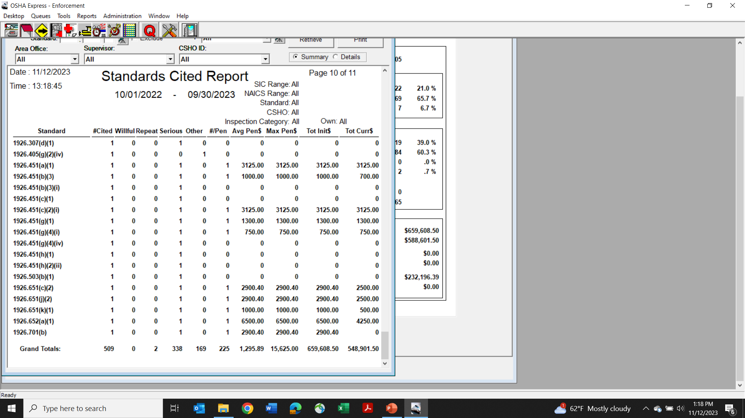
Health Hazards SEP
105 inspections in FY2023
Most common violations are silica in construction, hazard communication, and respiratory protection – all of which are related to health exposures.
3.24 SWR violations per inspection (average for all inspections is 1.61).

Slide 48
Health Hazards SEP
105 inspections in FY2023
Most common violations are silica in construction, hazard communication, and respiratory protection – all of which are related to health exposures.
3.24 SWR violations per inspection (average for all inspections is 1.61).

Slide 49
Health Hazards SEP
105 inspections in FY2023
Most common violations are silica in construction, hazard communication, and respiratory protection – all of which are related to health exposures.
3.24 SWR violations per inspection (average for all inspections is 1.61).

Slide 50
Health Hazards SEP
105 inspections in FY2023
Most common violations are silica in construction, hazard communication, and respiratory protection – all of which are related to health exposures.
3.24 SWR violations per inspection (average for all inspections is 1.61).

Slide 51
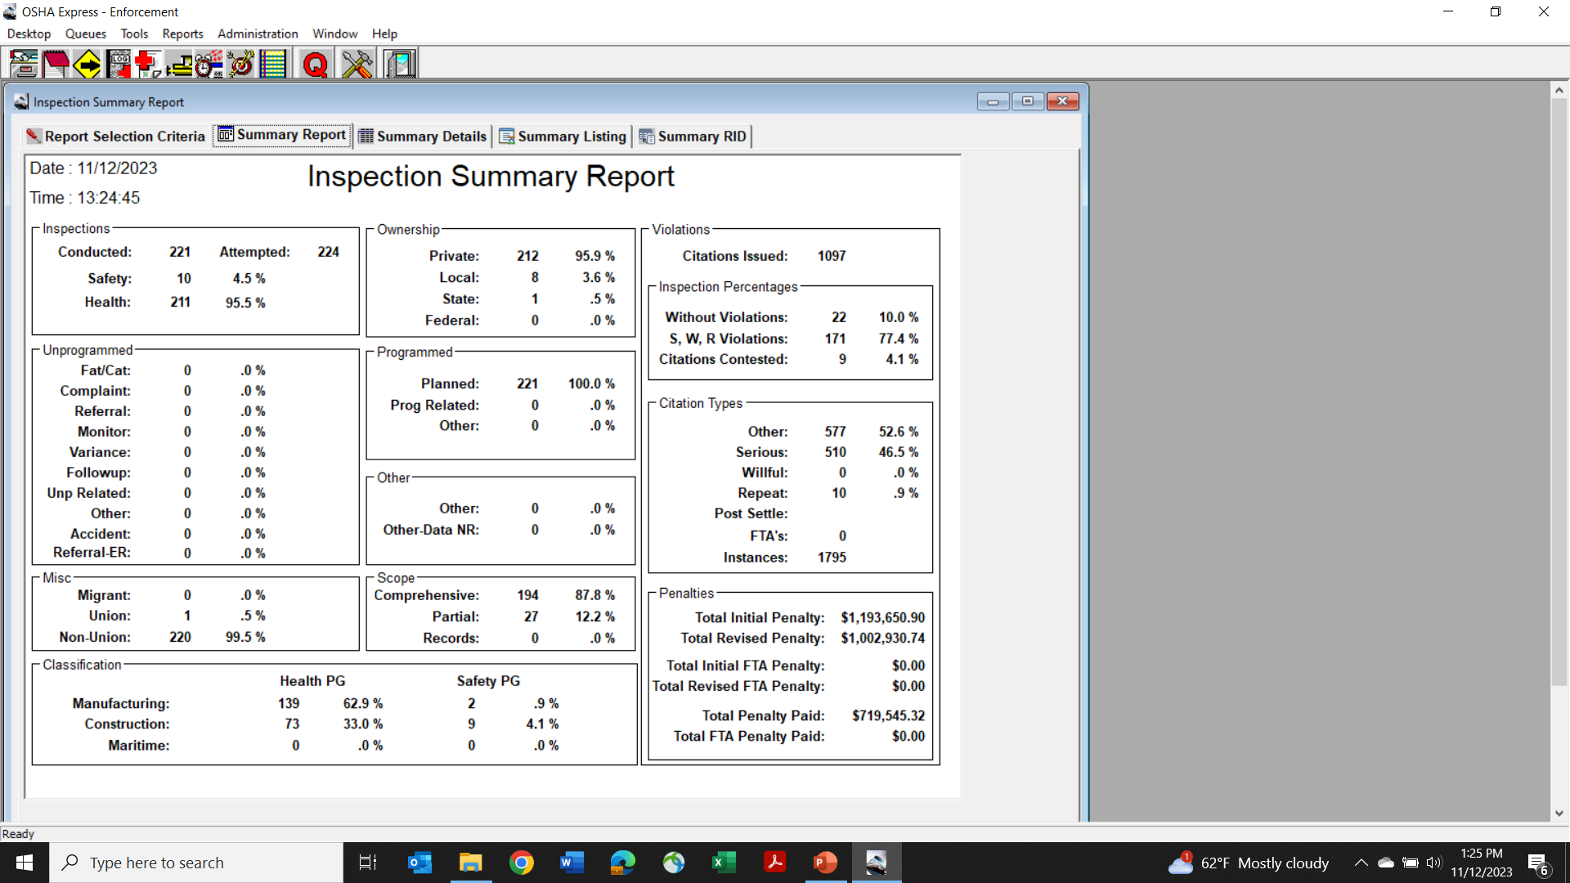
Health Hazards SEP
221 programmed planned (proactive) inspections conducted from FY19-23.
Includes both manufacturing (64%) and construction (36%).

Slide 52
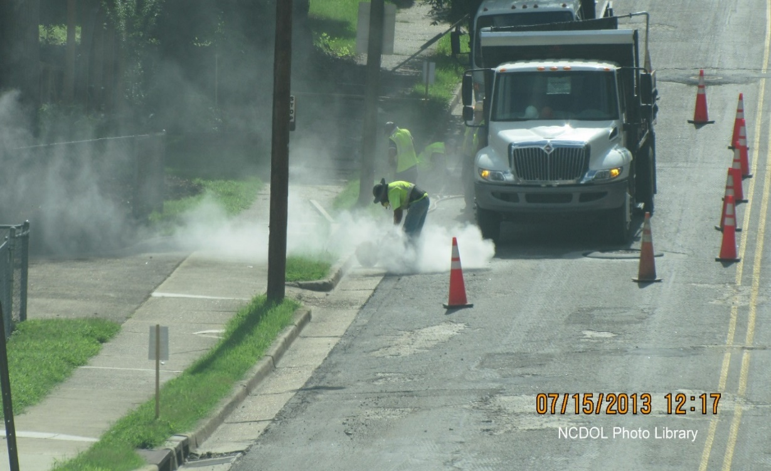
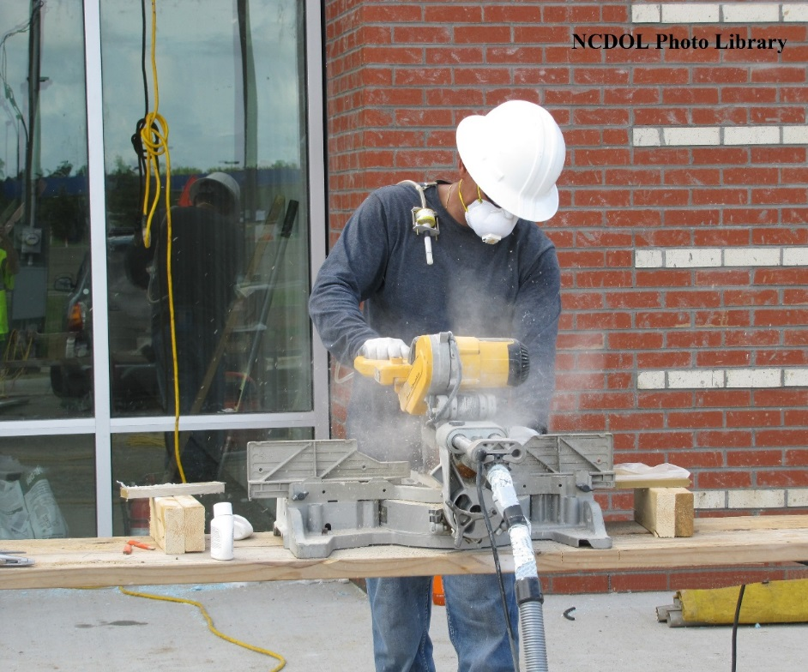
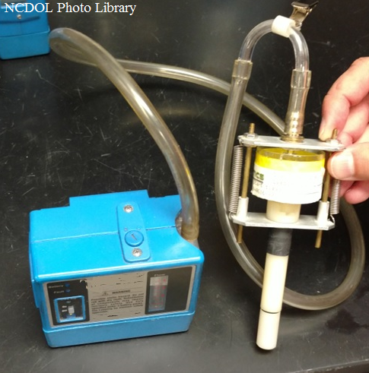
Evaluating Silica Exposure

Slide 53
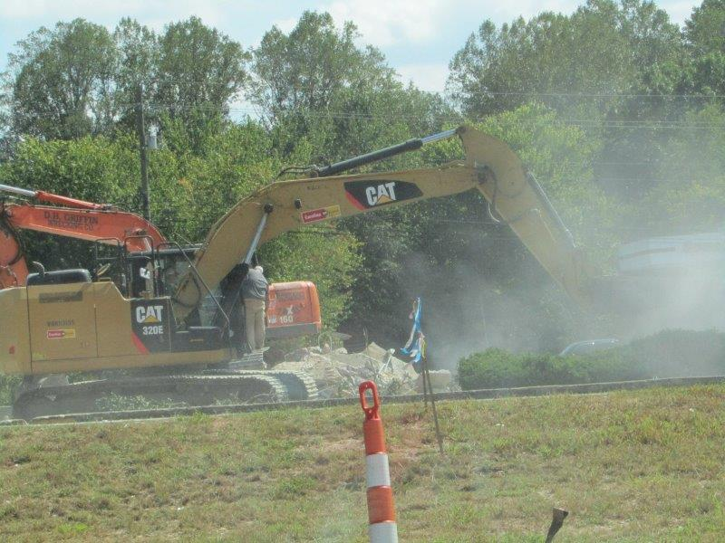
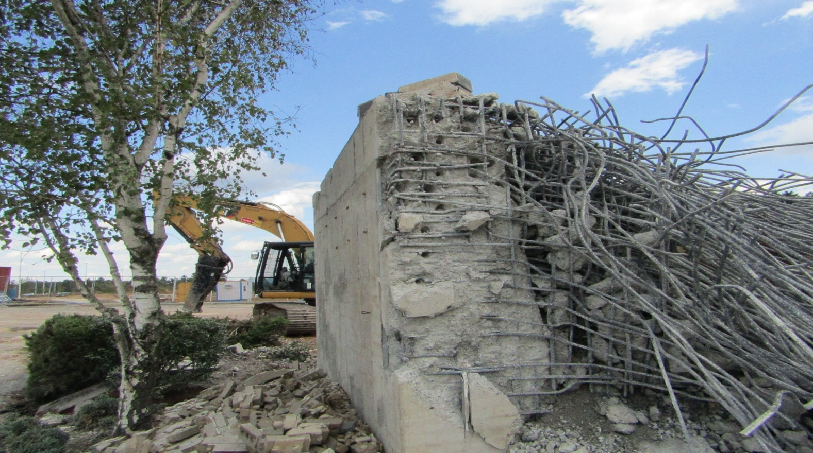
Silica Example

Slide 54
Table 1 of 29 CFR 1926.1153
Equipment/task
Engineering and work practice control methods
xvii) Heavy equipment and utility vehicles used to abrade or fracture silica-containing materials (e.g., hoe-ramming, rock ripping) or used during demolition activities involving silica-containing materials | Operate equipment from within an enclosed cab
 | When employees outside of the cab are engaged in the task, apply water and/or dust suppressants as necessary to minimize dust emissions

Slide 55
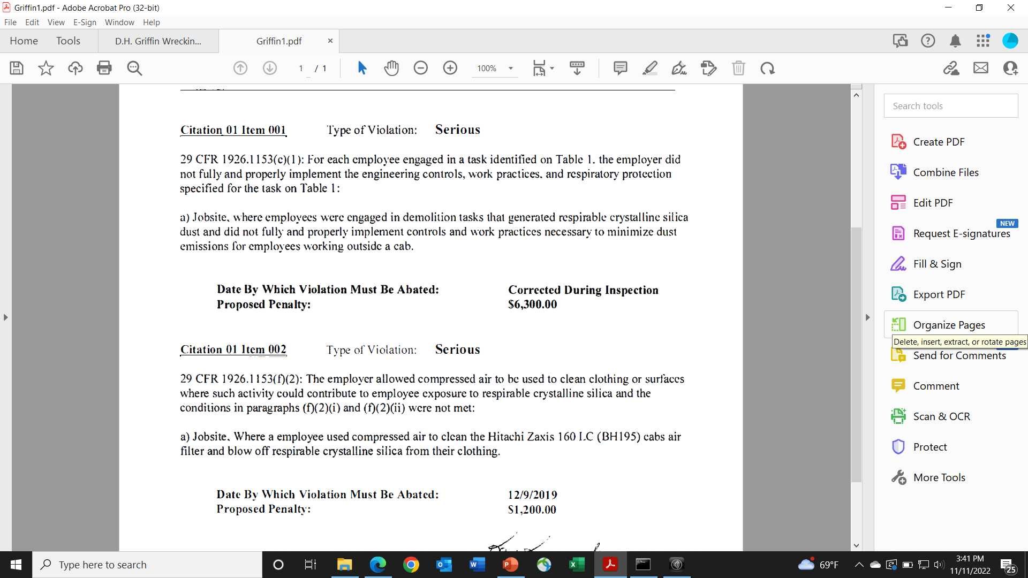
Citation 1, Item 1

Slide 56
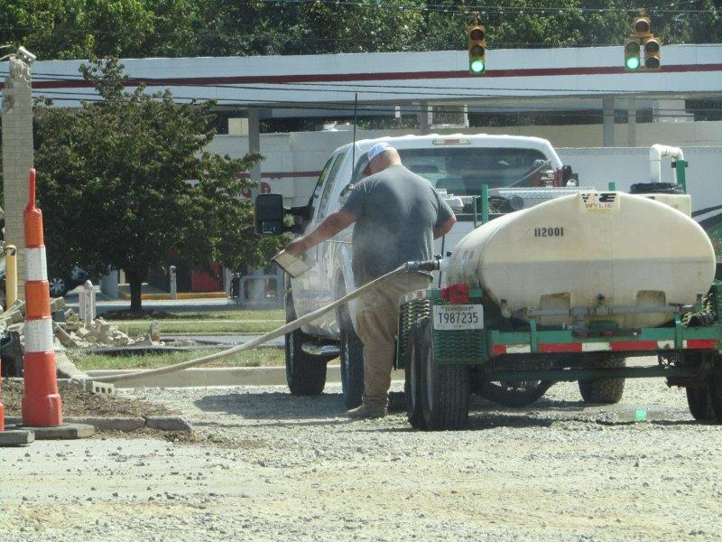
Citation 1, Item 2

Slide 57
Final ALJ Decision

Slide 58
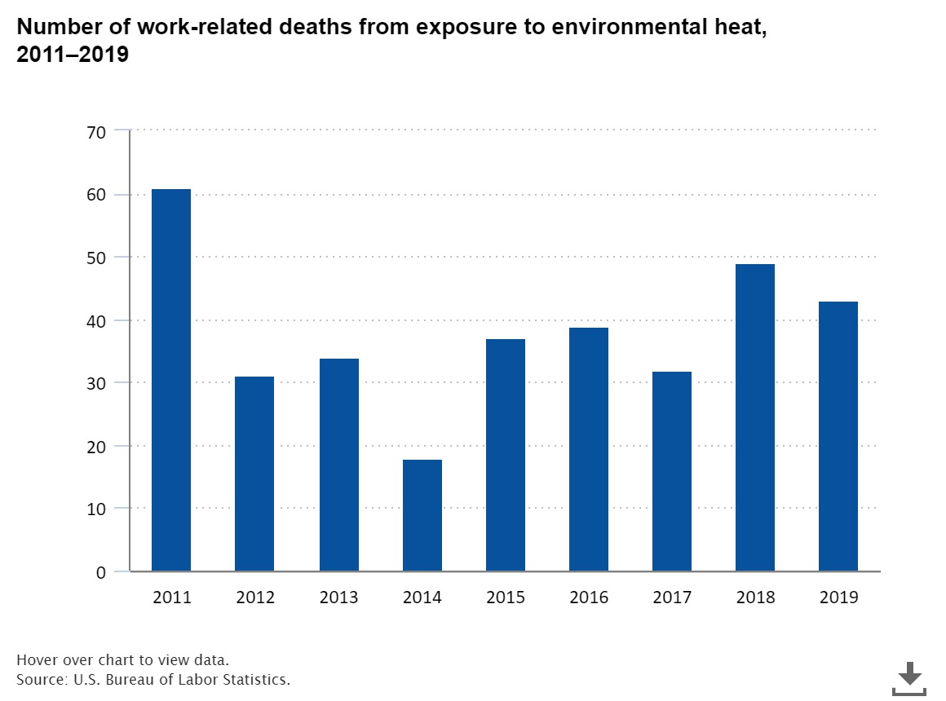
Preventing Heat-Related Illnesses
400 fatalities from 2011-2020
56
2020

Slide 59
Preventing Heat-Related Illnesses
NC has started the process of developing a state-specific standard on preventing heat-related illnesses.
  Tied to Heat Index and has specific requirements above 80, 90, and 100 degrees.
  Currently at the fiscal note stage…with a long way to go.
Until a NC or federal standard is promulgated, hazards associated with heat exposure are addressed under the General Duty Clause.

Slide 60
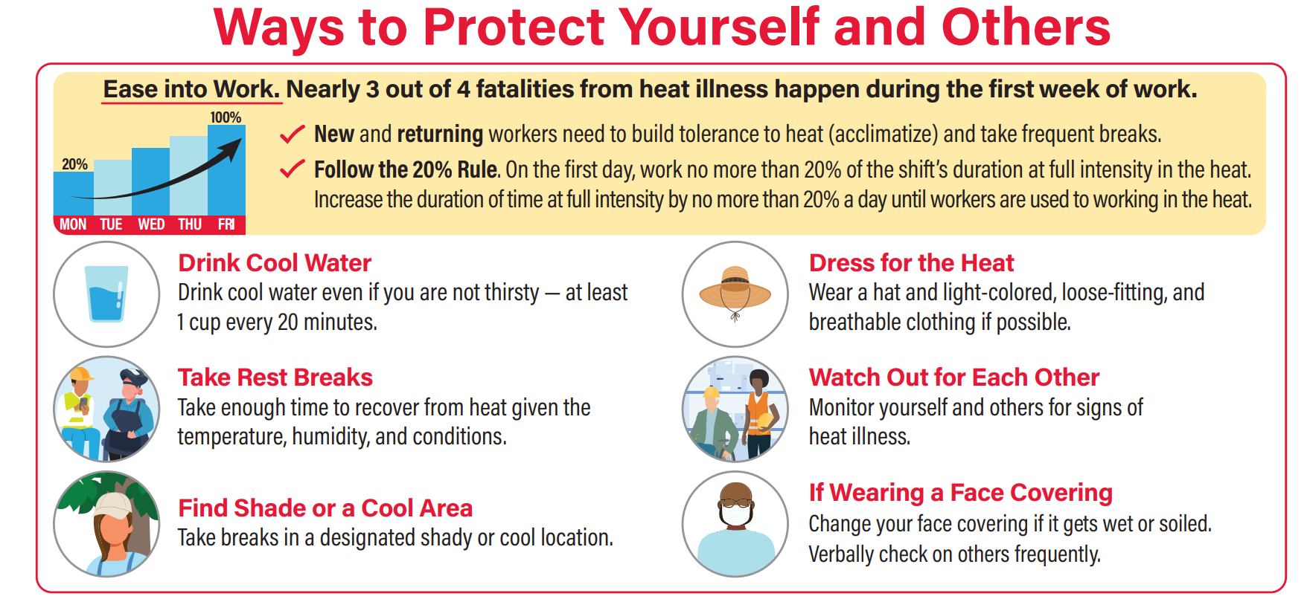
Heat Stress Prevention

Slide 61
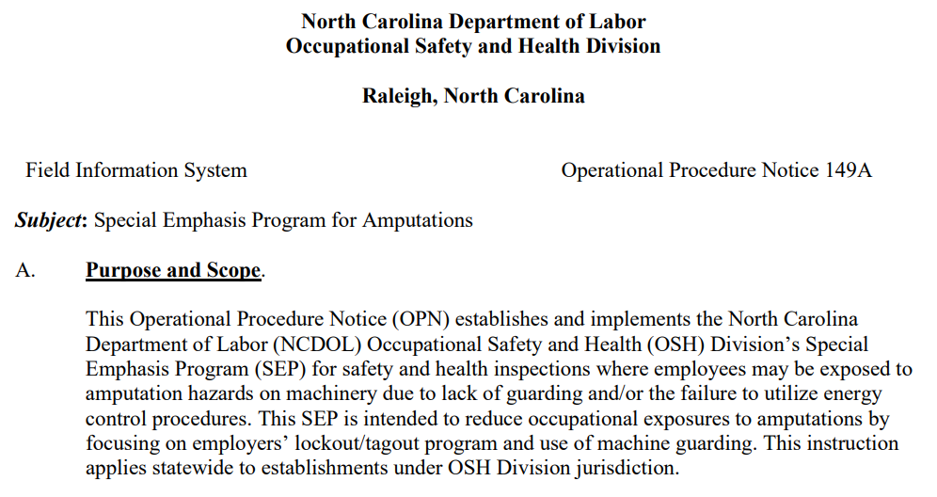
Amputations SEP

Slide 62
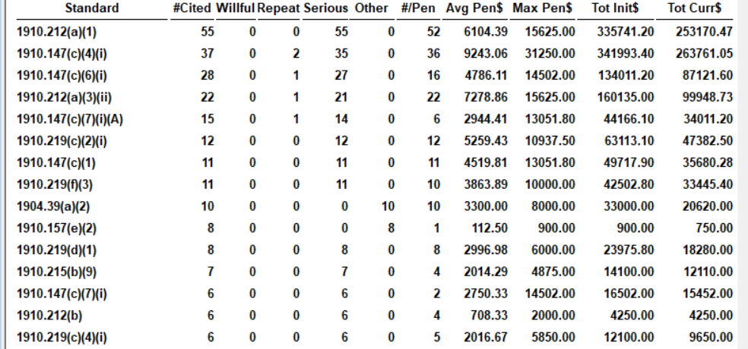
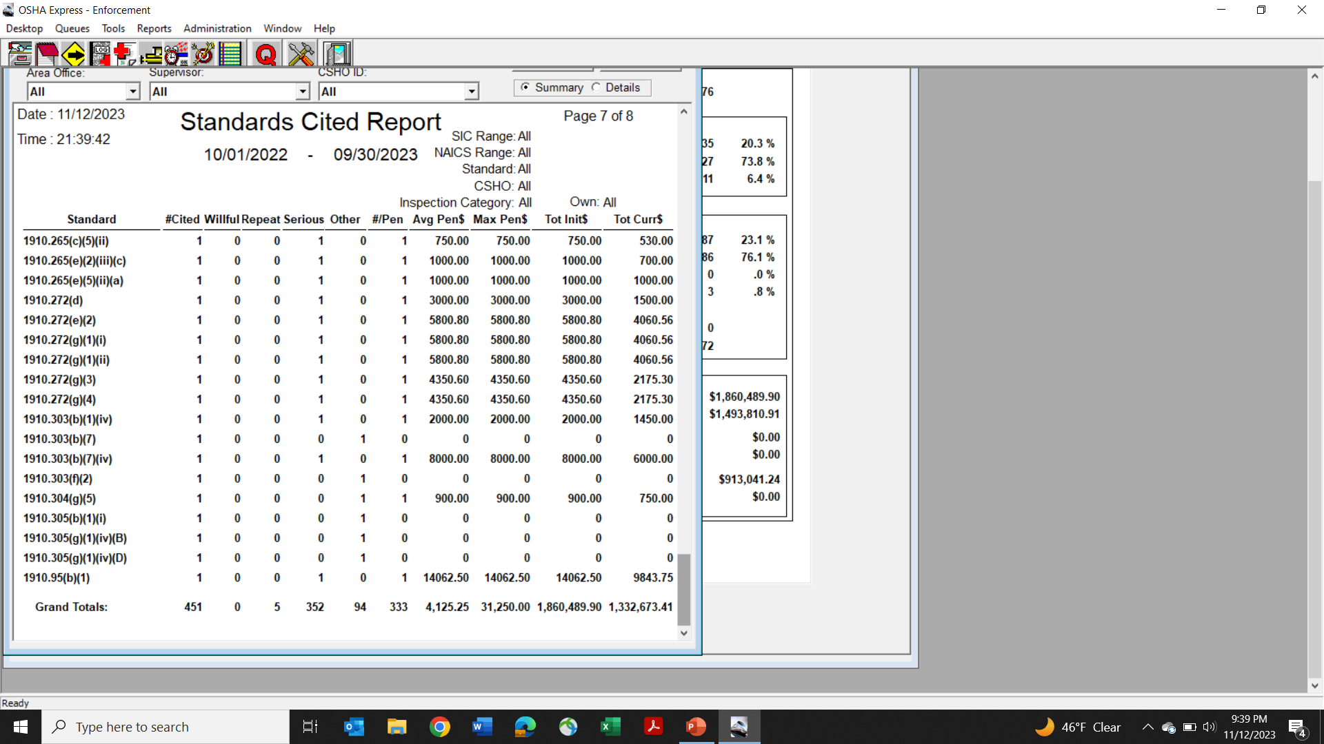
Amputations SEP – FY2023 Data
Conducted 172 total inspections, including 60 accidents, 19 complaints, and 73 planned
13 of the top 15 citations are for machine guarding or lockout/tagout violations.
2.08 SWR violations per inspection (average for all inspections is 1.60).

Slide 63
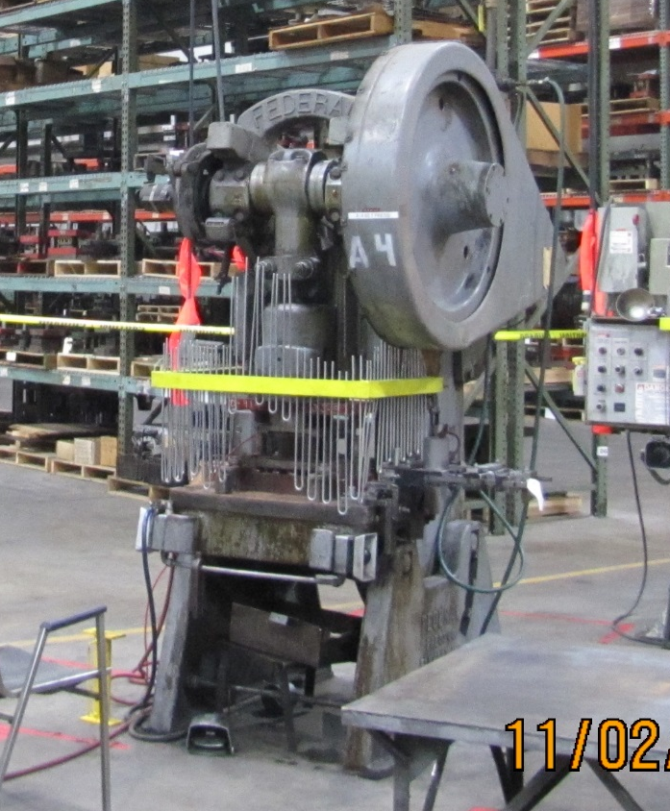
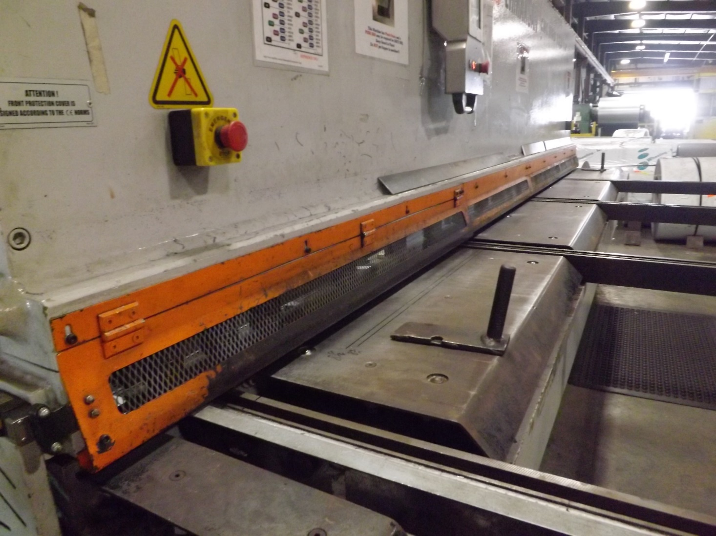
Machine Guarding
Notes:
Inspection #318122694, Photo by Tara Payne
Inspection #318146388

Slide 64
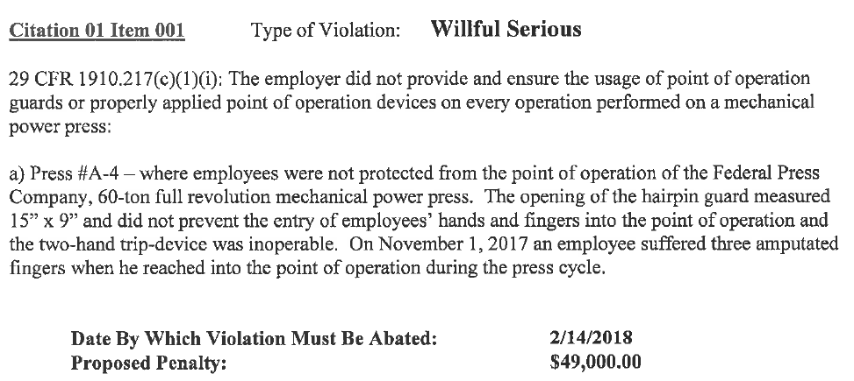
Example Machine Guarding Citation

Slide 65
Example LOTO Citation

Slide 66
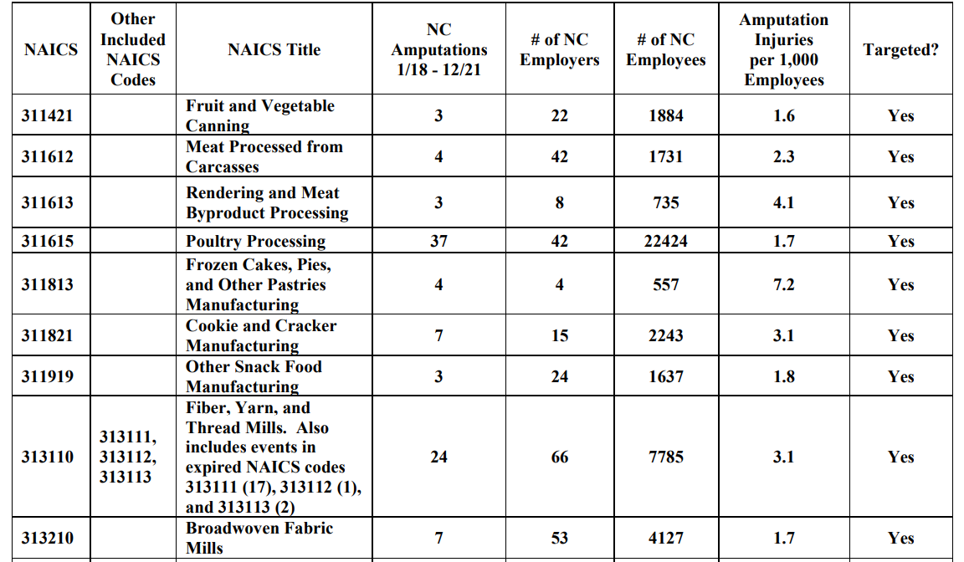
Amputations SEP Targeting Program

Slide 67
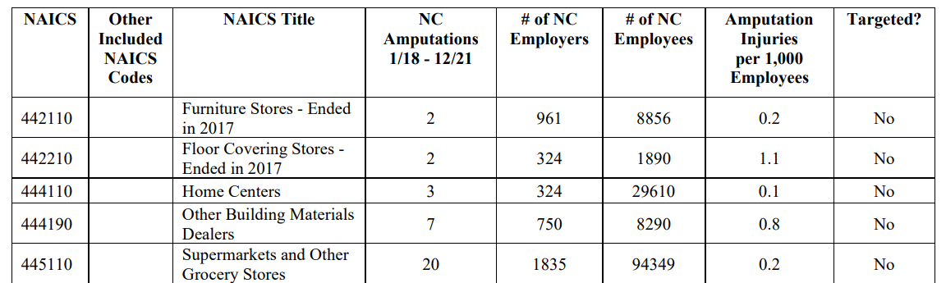
Amputations SEP Targeting Program

Slide 68

Amputations SEP – Targeting
226 programmed planned (proactive) inspections conducted in FY20-23. This is in addition to 407 unprogrammed inspections (e.g., complaints, accidents, etc.)
The proactive targeting program is based on NC-specific data.

Slide 69
OSHNC – Challenges for FY2024 (and beyond)
Recruiting and retention, especially of Compliance Safety and Health Officers (CSHOs).
  A significant percentage of our current OSHNC staff is either eligible for full retirement now or will be within the next five years.
The final NC budget surprisingly included language that removed OSHNC’s exemption from sending verbatim adoption rules through the NC rules-making process.
  This could result in new Federal OSHA standards not being adopted within the required 6-month time frame (or at all) – and hence jeopardize our “at least as effective as” requirement for an OSHA state-plan state.

Slide 70
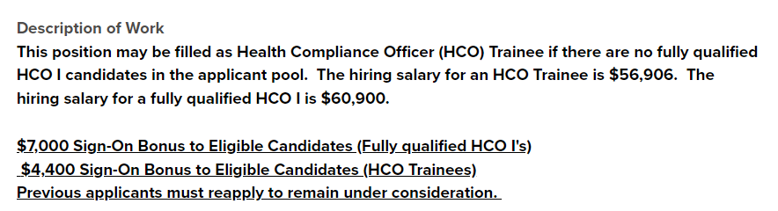
Recruiting – Safety and IH Trainees
Given the lack of fully qualified applicants for the SCO and HCO positions, we are starting to hire trainees who have an appropriate bachelor’s degree, but no experience…at all.

Slide 71
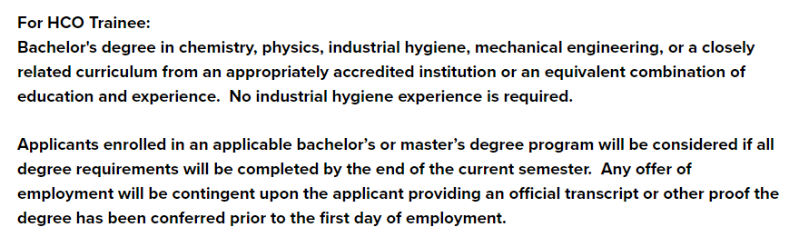
Recruiting – Safety and IH Trainees
If you know of any soon-to-be college grads with a degree in biology, chemistry, etc. who are undecided on a career, med school, etc., send them our way! We’ll pay them $56.9k with no experience and provide the industrial hygiene training.

Slide 72

Thank You For Attending!
Questions?
1-800-NC-LABOR
(1-800-625-2267)
www.labor.nc.gov
Notes:
72

